Slide 1
Adjustable Table
Proposal By: Jordan Perrin, Jamie Rinderle, Emily Speck, and Noah Shaefer

Slide 2
Why?
Residents need a table with more accessibility
Due to the unique nature of each wheelchair, the table needs changing parameters to meet the residents’ needs
This table will allow for the residents to eat more comfortably
Table is sturdy and can be used for anything.

Slide 3
Design:
Tabletop made out of wood
Tabletop will separate into four triangular sections
Adjustable tabletop for four separate residents
Shape:
square with rounded corners (safety)
Lazy Susan in center raised above the table
All four sections will have their own base
Foam edges on table will keep things from falling off and eliminate chance of injury.

Slide 4
Design:
Table section
Able to function as a separate table

Slide 5
Design:
Full Table Assembly
A “Lazy Susan” is in the center for condiments, napkins, etc.

Slide 6
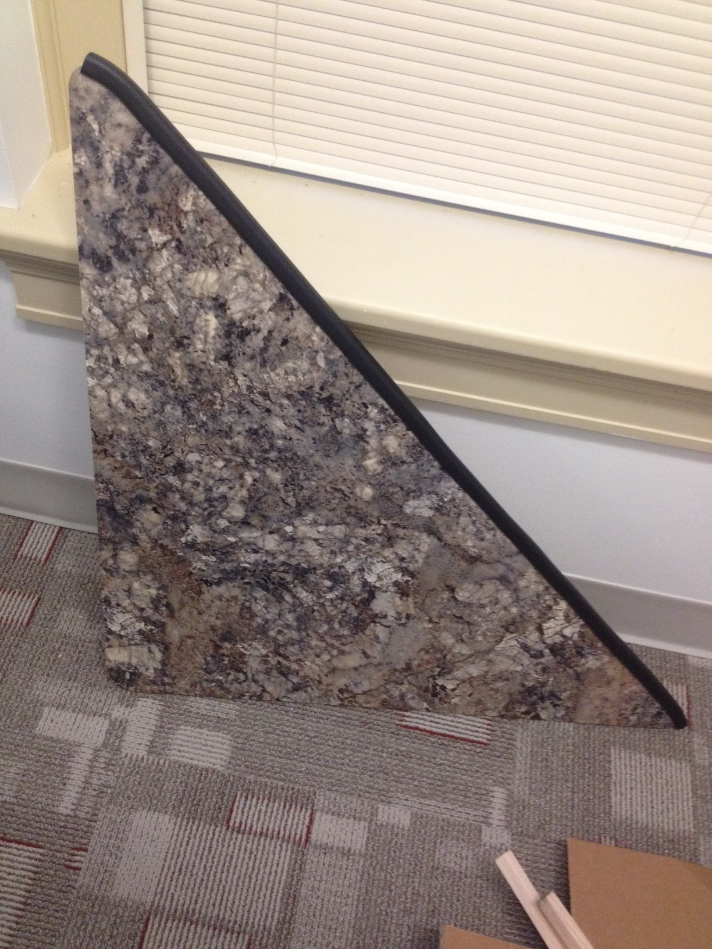
Pictures

Slide 7
Design Changes
The technology for the adjustable column is a self contained adjustable column.
Dimensions have increased from four feet to four and a half feet to add more space for larger chairs.
The staff asked for a lazy susan in the center, which has been implemented.
The bottom will no longer be a tri pod style base. It will have two legs extending along the sides of the table, as seen in the drawings.

Slide 8
What is done?
Table top
Ordered aluminum and currently in the process of ordering the I-Columns
Only needs to assembled.
Current Price Estimate: ~$797.15
JWF I-Columns: ~$400
wood and laminate: $106.90
cnc cutting for wood ~$30.00
aluminum: $104.70
foam edging: $19.97
velcro and vinyl: $45.58
welding ~ $120.00

Slide 9
Future Plan
Start building entire table over break.
Noah will weld the legs and I-Columns as needed.
Hopefully finish the table next semester.

Slide 10
Questions?

